Slide 1


Japanese Braille 4 All
Alexis Culpin
L2 Frontières du Vivant
CRI

Slide 2
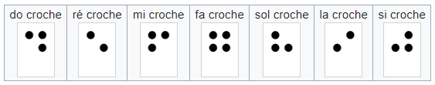


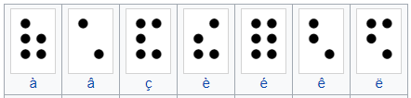
The braille is not an universal language
Musical braille
Informatic braille
Mathematics braille
French braille

Slide 3
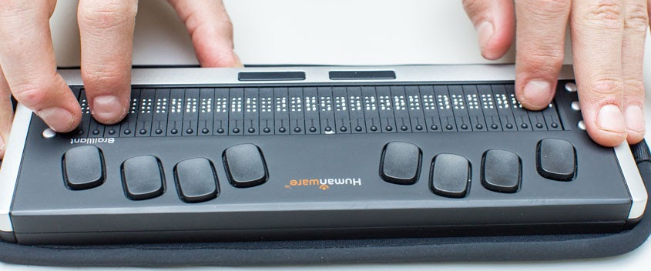
The problem
Braille documentations are not compatible with screen reader and braille computer
Adapted tools are only working for one Braille language

Slide 4
Japanese Braille 4 All
Accessible documentation
Transcription program
Incorporation in braille machine

Slide 5
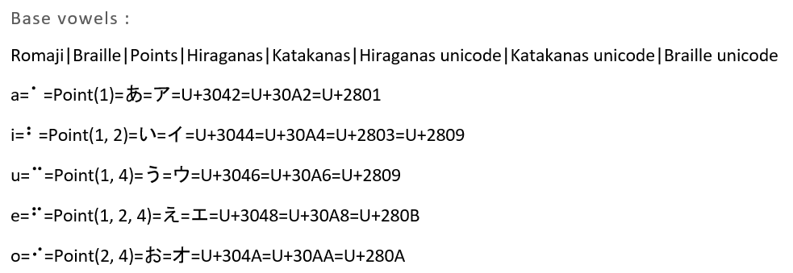
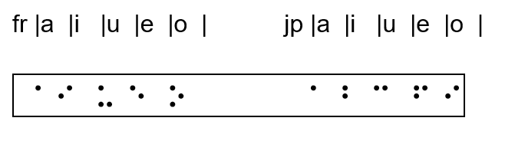
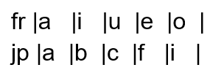

Japanese Braille 4 All
Achievements
Accessible documentation
Transcription program
Incorporation in braille machine
1 Documentation compatible with screen reader
2 Documentation compatible with Braille computer
Learning outcome
Formatting/synthesizing
information
Learn Japanese Braille

Slide 6
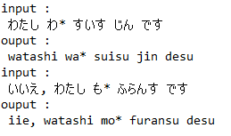
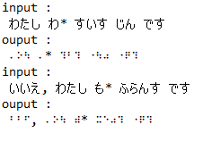
Japanese Braille 4 All
Achievements
Accessible documentation
Transcription program
Incorporation in braille machine
Learning outcome

Slide 7
Japanese Braille 4 All
Achievements
Accessible documentation
Transcription program
Incorporation in braille machine
Learning outcome

Slide 8
Acknowledgment

